Slide 1
HomeEconomy WebSite
Achiya Ben Natan:213934599
Yuval Musseri 213358039
Liel Yoash:206477788
Maor Berenstein:212305965
Nevo Gadassi:325545887

Slide 2
Division of labor
Yuval Musseri
Nevo Gadassi
Achiya Ben Natan
Maor Berenstein
Liel Yoash
Build the backend
Help with the code in database
Planing the backend
Upload the database to render
Connect the backend to the database
Help in front
Planing the fronted
Build the fronted
Design all the project
Project manager
Connecting all parts of the project and handling bugs
war hero
a soldier
Code help in all parts of the project

Slide 3

Project description
Home Economy, we understand the intricate dynamics of a household and the countless responsibilities that come with it. Our mission is to empower you with the tools and resources to streamline tasks, foster collaboration, and enhance the overall well-being of your family.

Slide 4
Our vision
We envision a world where every family experiences a harmonious balance in managing their day-to-day activities. Home Economy strives to be the go-to platform that not only eases the burden of domestic responsibilities but also strengthens the bonds within your family.

Slide 5
Goals
Supportive Community:
Efficiency
striving to establish a supportive community. Connect with like-minded individuals, share experiences, and build a thriving support system for families.
We aim to streamline household responsibilities by providing families with a user-friendly platform for easy task organization, promoting better coordination for all members.

Slide 6
Why Choose HomeEconomy?
Simplicity: Our user-friendly interfaces cater to users of all ages and tech-savviness, ensuring that every family member can actively participate in managing household tasks.
Empowerment: Home Economy empowers families to take control of their home economy, enabling them to focus on what truly matters – the well-being and happiness of their loved ones.
Privacy and Security: We prioritize the utmost security measures to safeguard your family's data, ensuring a safe and secure environment for all users.

Slide 7
Management requirements
All Child feature
See finishtask
ChangeTask
Set done to task
Send\receive notification
parents
child
See todotask
Add task
Add family member

Slide 8
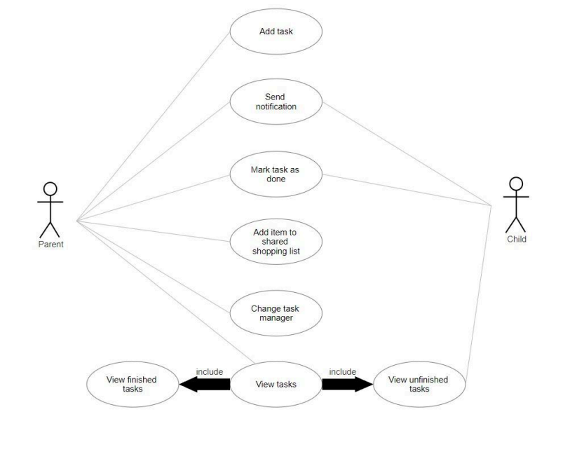

Slide 9
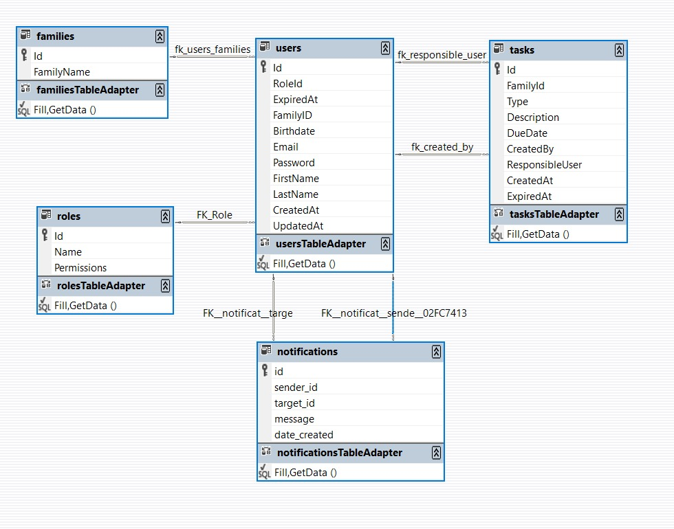
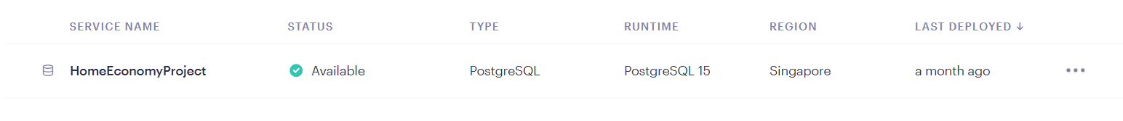
Data Base

Slide 10
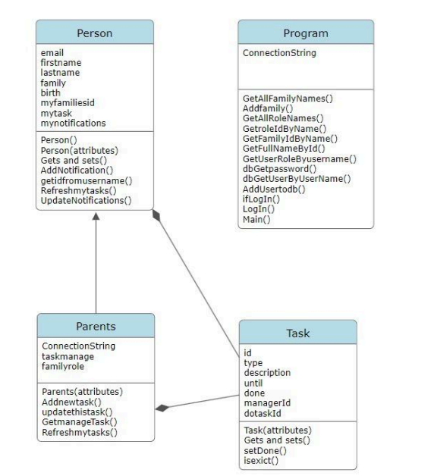
class diagram

Slide 11
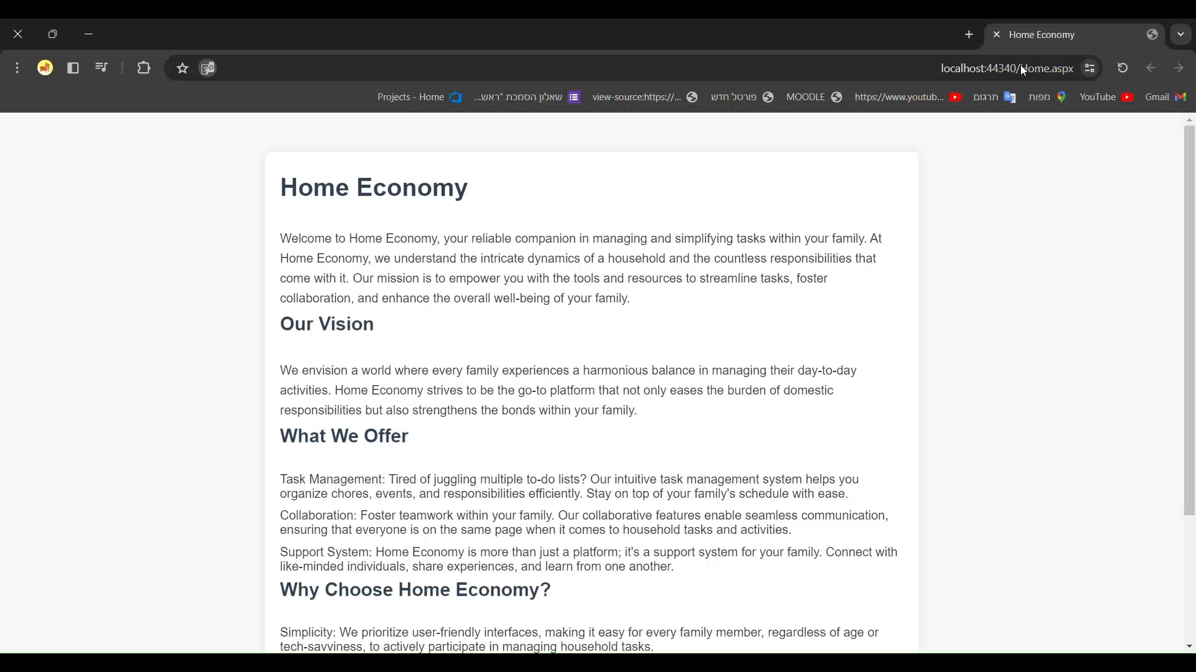
Running the childspace

Slide 12
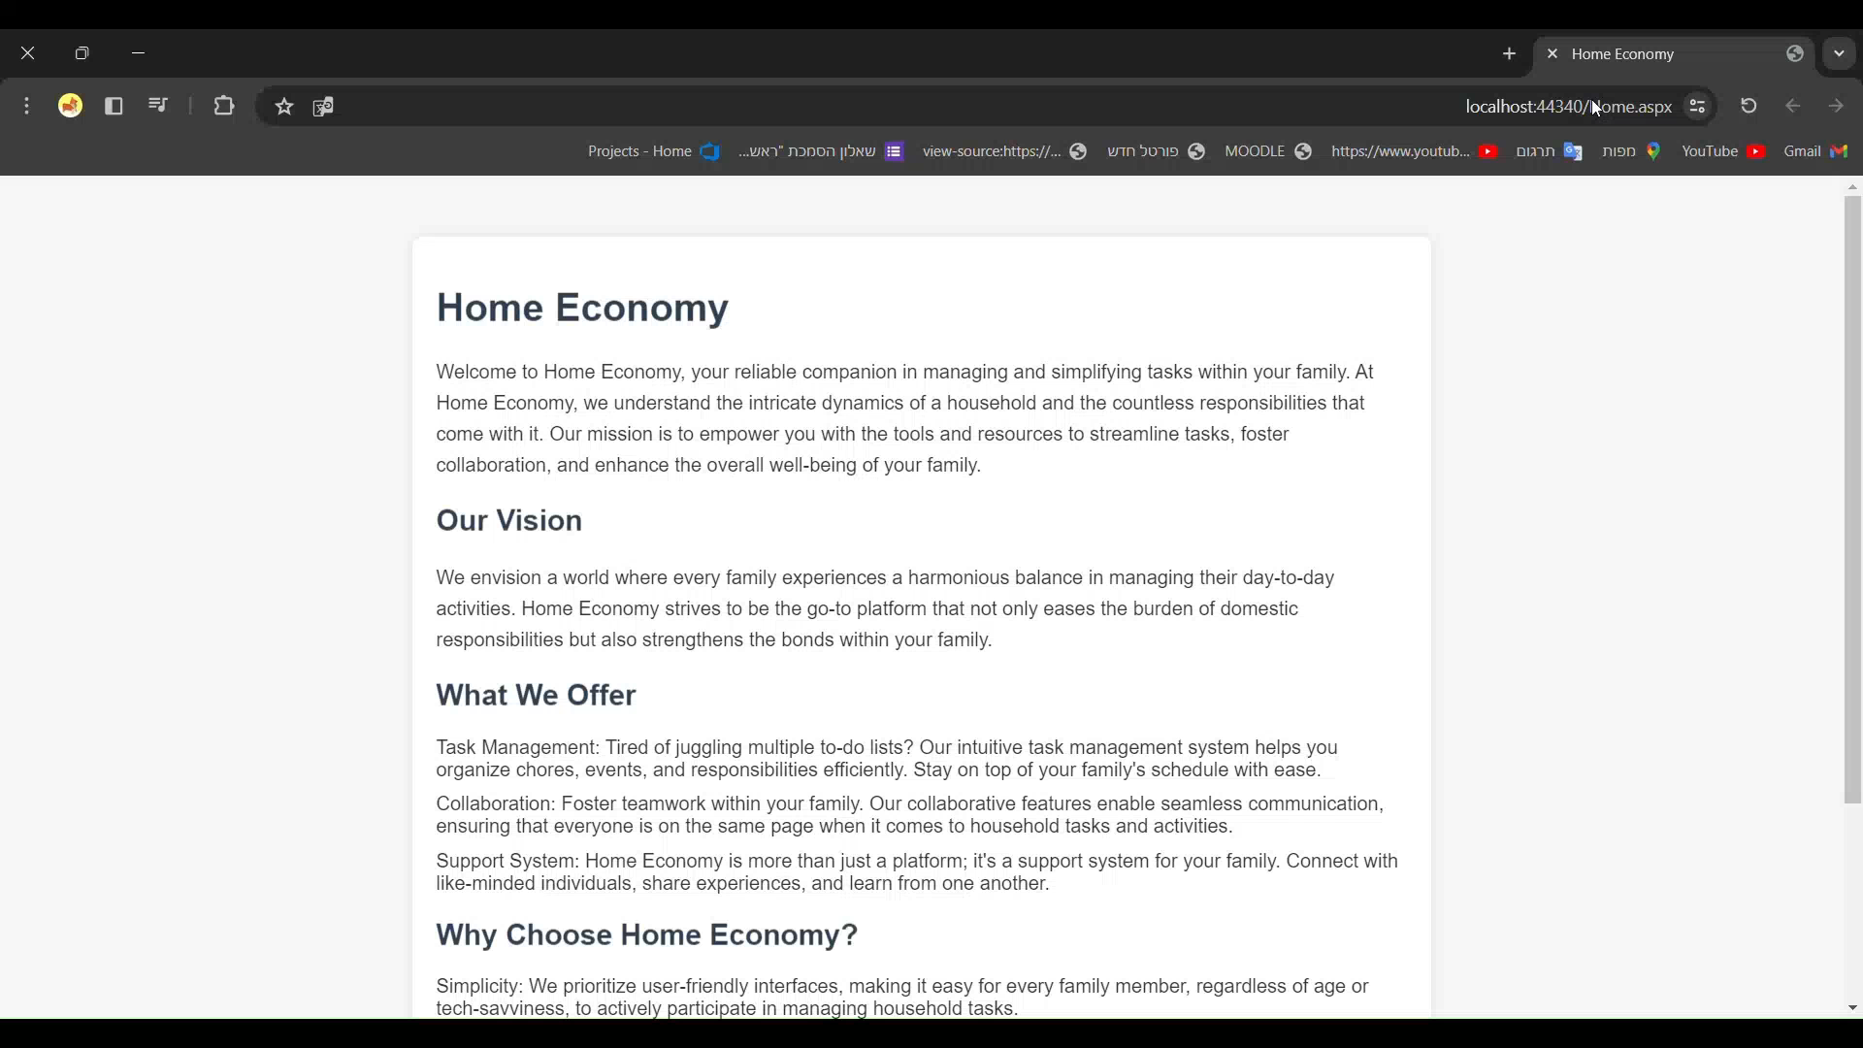
Running the parentspace

Slide 13

Running SingUp

